Slide 1
THE TECHNICAL COLLEGE OF LY TU TRONG
  Faculty of IT
  Ho Chi Minh City, September 2017

Slide 2
INTRODUCTION
  Faculty of IT
Notes:
Last updated March 9th 2006
Created Spring 2003
Author: J. Maleic
General overview of Computer Science Undergraduate Program

Slide 3
CONTENT
The staff
The department
Students
Training Systems
Majors
Output
Job in ICT
Reward

Slide 4
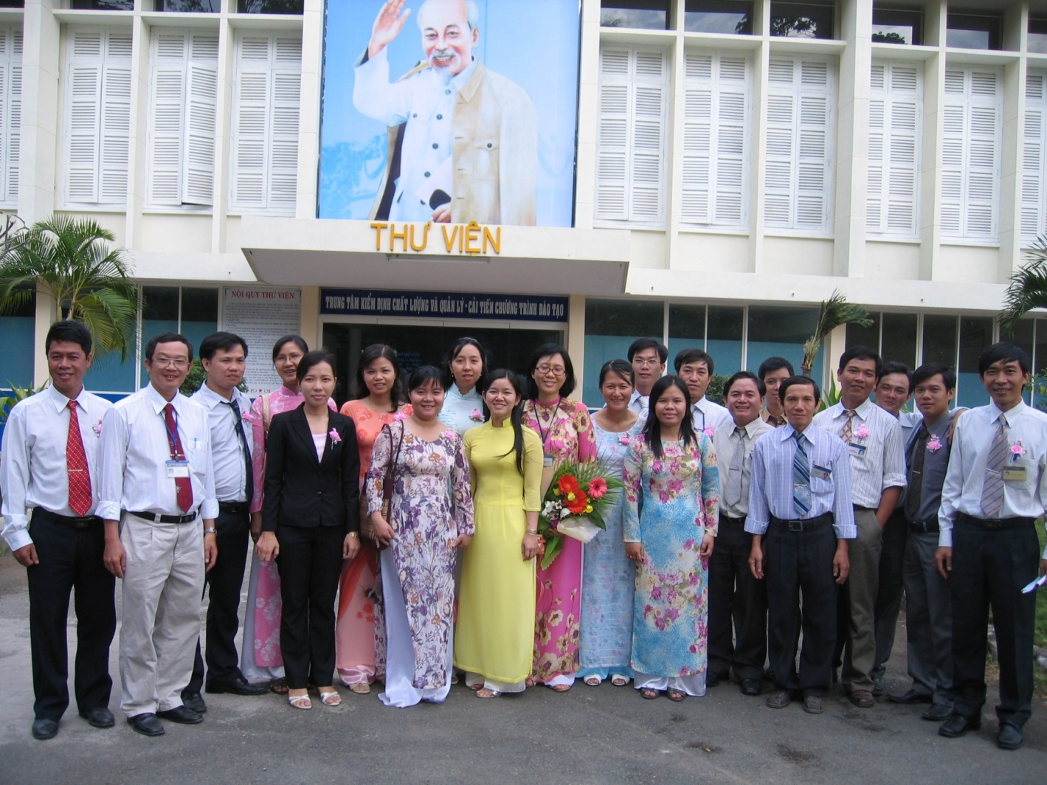
THE STAFF
The staff of IT faculty

Slide 5
THE STAFF
Lecturers (28)
Masters |  | Graduated Bachelors | Graduated Engineer
Graduated | Studying
10 | 5 | 10 | 3

Slide 6
THE DEPARTMENT
Faculty of IT
Computer and Science
Software
Network

Slide 7
STUDENTS
There are over about 1000 students :
+ 500 vocational college students
+ 500 technical vocational students
➔ 300 students from secondary level (12+2)
➔ 200 students from high school level (9+3)

Slide 8
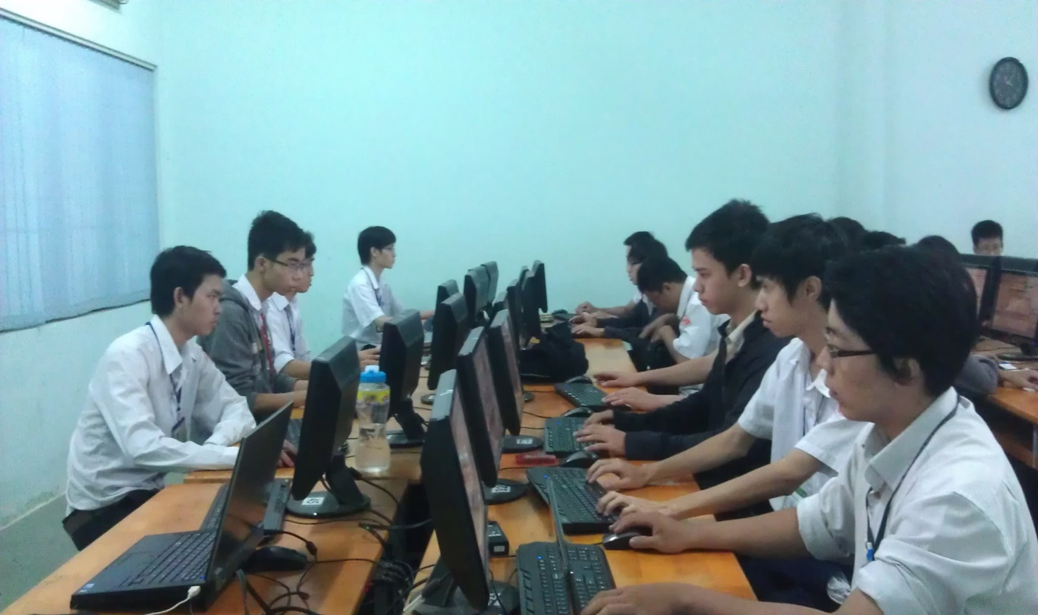
STUDENTS
Students majored in Computer Programming

Slide 9
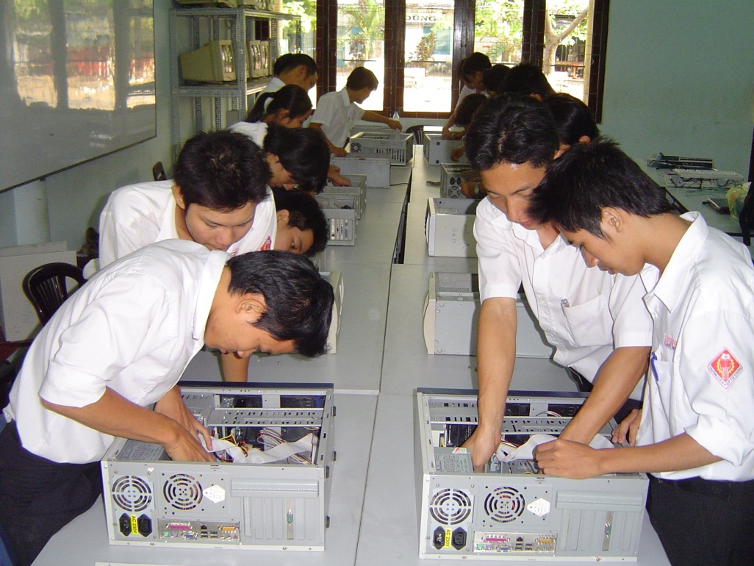
STUDENTS
Students majored in Computer Hardware

Slide 10
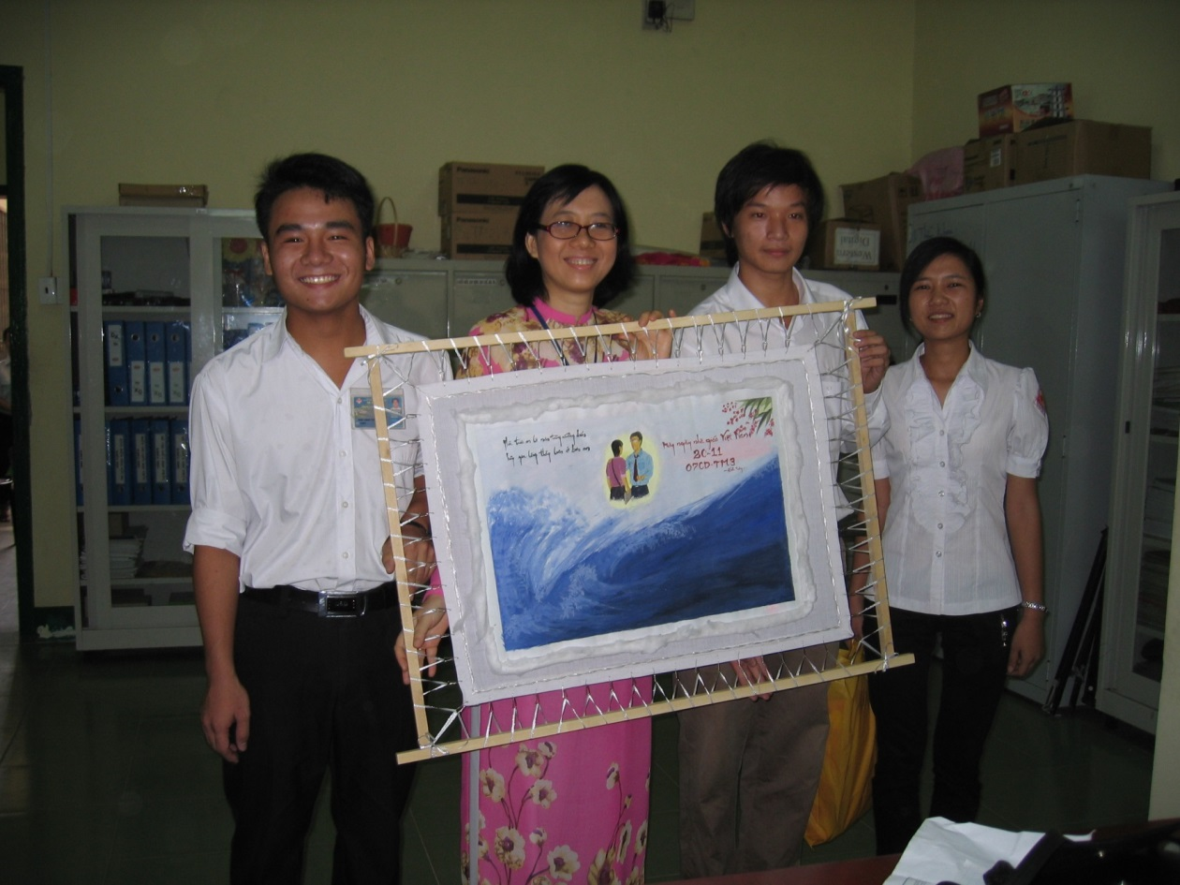
STUDENTS
A gift from students on Teacher Day

Slide 11
Training systems
No. | Training System | Number of years | Certification
1 | Technical College | 3 | Technical College Degree
2 | Vocational College | 3 | Vocational College Degree
3 | Vocational High School | 1.5 | Vocational Degree/High School diploma
4 | Vocational Secondary School | 4 | Vocational College Degree

Slide 12
Majors/Specialty
Software
Computer Programing
Web Design
Network
Network Security
Computer Hardware
Computer and Science
Applied Informatics
Network Administration

Slide 13
OUTPUT
Graduation practice: 100% students have
Employment rate after 6 months of graduation
    83% has jobs immediately
    72% has jobs that is suitable for their majors
Vocational students: 100% has jobs after graduating

Slide 14
Jobs in ICT after graduating
Computer Systems Manager
Help Desk Specialist
Help Desk Technician
IT Support Manager
IT Support Specialist
Officer
IT Systems Administrator
Network Systems Administrator
Programmer
Web Administrator
Webmaster
Web Developer

Slide 15
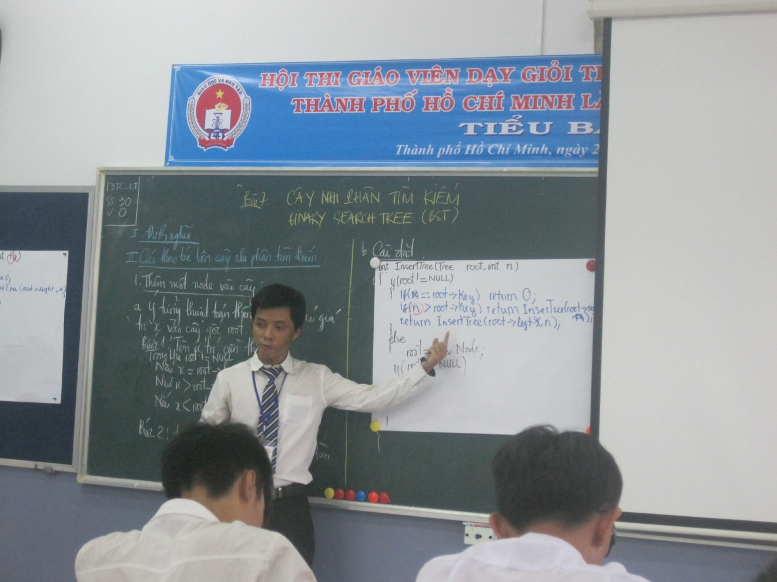
REWARDS
A lecturer from IT faculty received 3rd Prize in teaching contest 2015

Slide 16
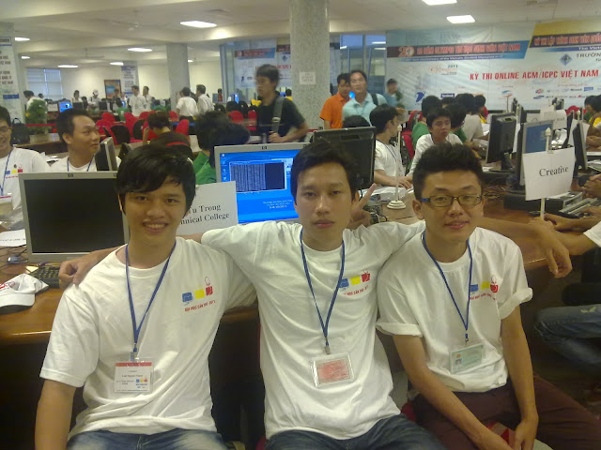
REWARDS
Students from IT faculty received 3rd Prize in National Olympic Contest 2014

Slide 17
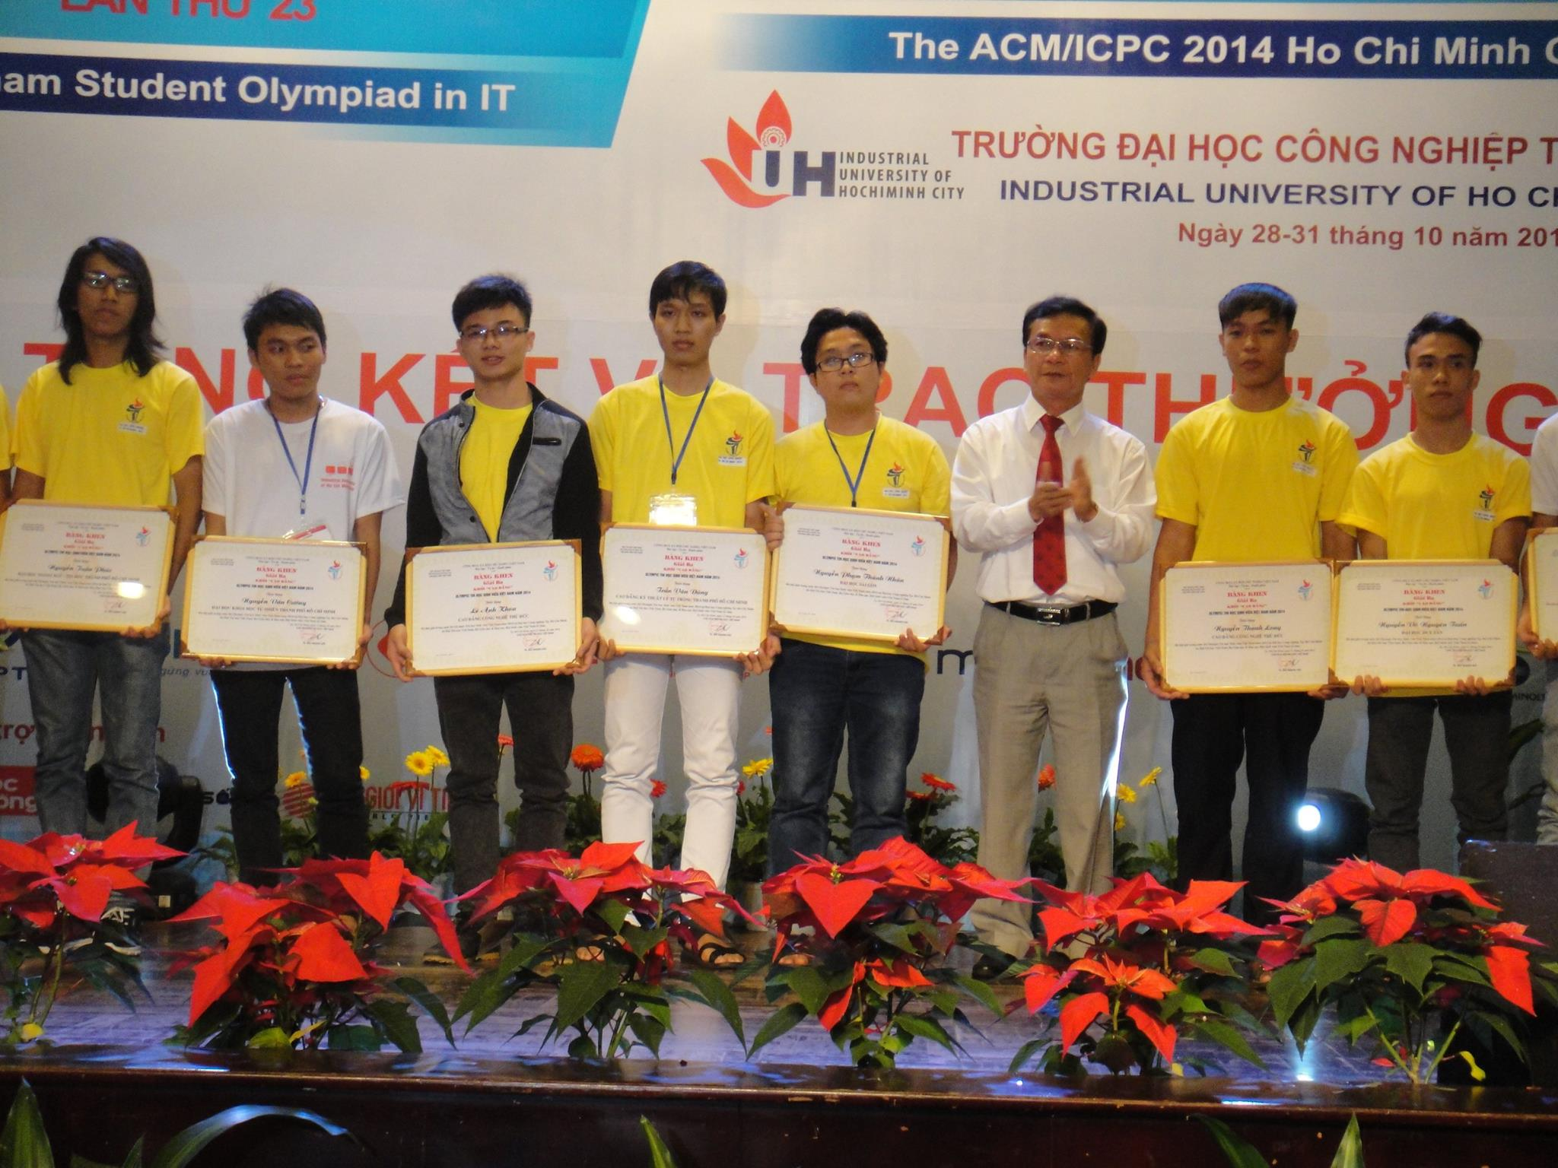
REWARDS
Students from IT faculty received 3rd Prize in National Olympic Contest 2014

Slide 18
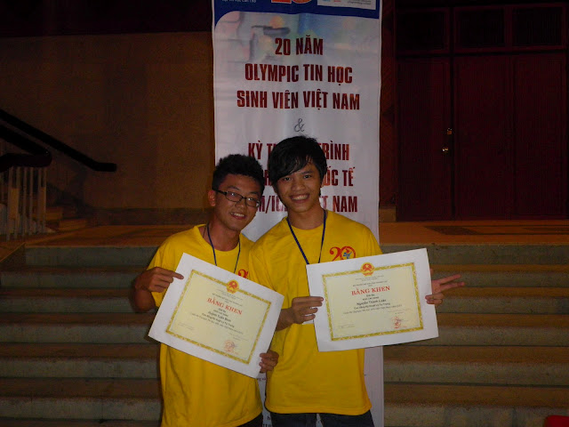
REWARDS
Students from IT faculty received 3rd Prize in National Olympic Contest 2014

Slide 19
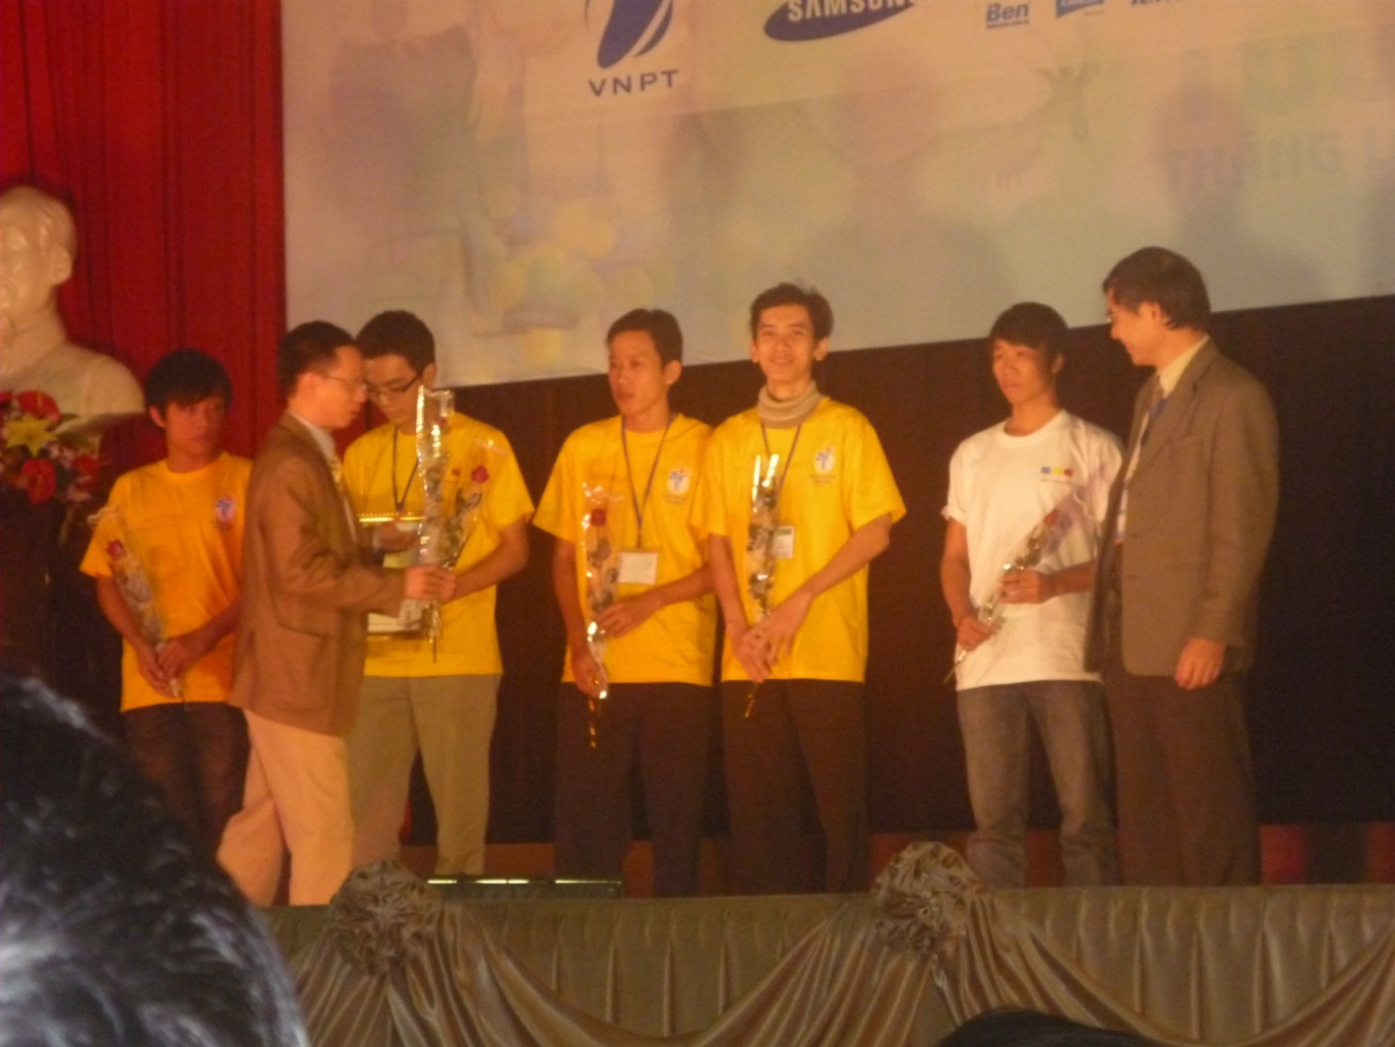
REWARDS
Students from IT faculty received 3rd Prize in National Olympic Contest 2014

Slide 20
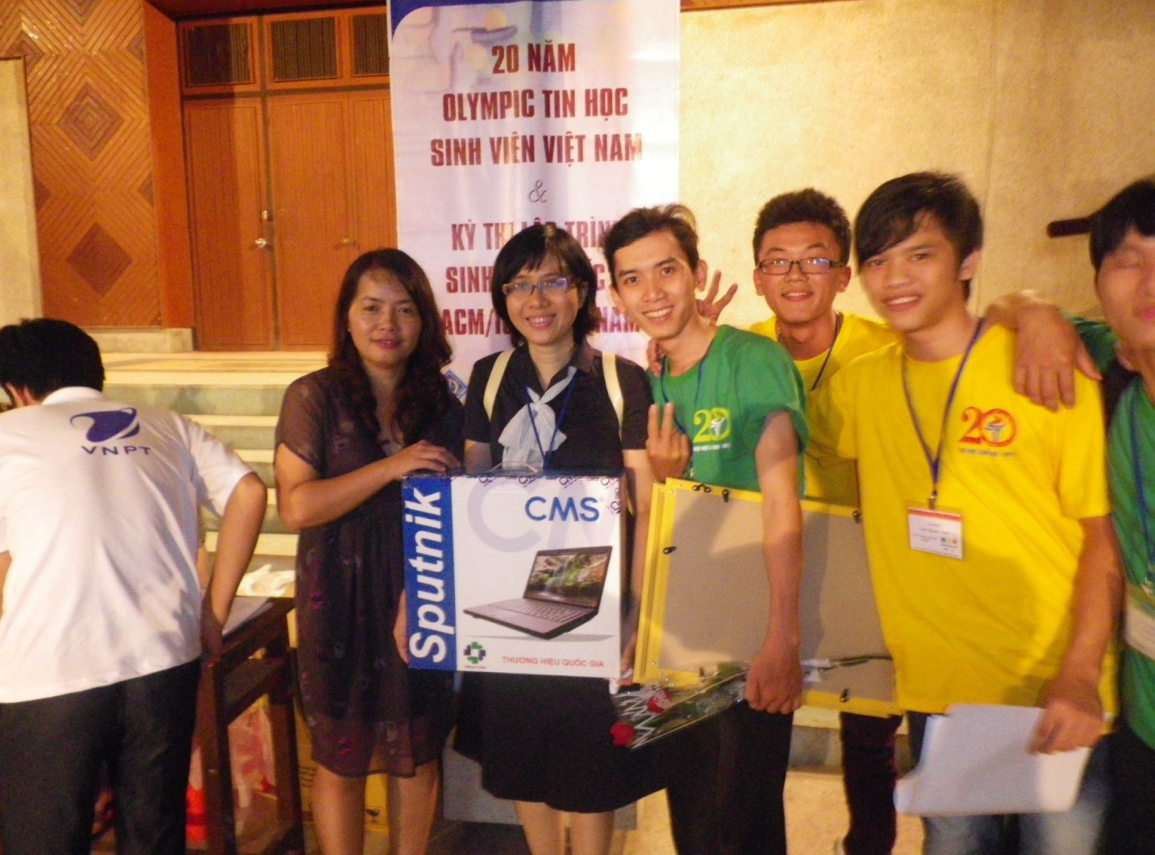
REWARDS
Students from IT faculty received 3rd Prize in National Olympic Contest 2014

Slide 21
REFERENCE
http://ltt.edu.vn/

